Slide 1

Fundamentals of Management Project
Unit 5
​
Submitted by
Varun Kumar 2K19/IT/140
Department of Information Technology, DTU​

Slide 2
What is knowledge management?
Knowledge management (KM) is the process of organizing, creating, using, and sharing collective knowledge within an organization.
Successful knowledge management includes maintaining information in a place where it is easy to access.
Only a few initiatives are able to truly transform how an organization operates, and knowledge management is one of them.

Slide 3
Types of knowledge
Tacit knowledge
This type of knowledge is typically acquired through experience, and it is intuitively understood.
As a result, it is challenging to articulate and codify, making it difficult to transfer this information to other individuals.
Examples of tacit knowledge can include language, facial recognition, or leadership skills.

Slide 4
Implicit knowledge
While some literature equivocates implicit knowledge to tacit knowledge, some academics break out this type separately, expressing that the definition of tactic knowledge is more nuanced.
While tacit knowledge is difficult to codify, implicit knowledge does not necessarily have this problem. Instead, implicit information has yet to be documented.
Explicit knowledge
Explicit knowledge is captured within various document types such as manuals, reports, and guides, allowing organizations to easily share knowledge across teams.
This type of knowledge is perhaps the most well-known and examples of it include knowledge assets such as databases, white papers, and case studies.

Slide 5
Knowledge management process
Effective knowledge management system typically goes through three main steps:
Knowledge Creation: During this step, organizations identify and document any existing or new knowledge that they want to circulate across the company.
Knowledge Storage: During this stage, an information technology system is typically used to host organizational knowledge for distribution. Information may need to be formatted in a particular way to meet the requirements of that repository.
Knowledge Sharing: In this final stage, processes to share knowledge are communicated broadly across the organization. The rate in which information spreads will vary depending on organizational culture. Companies that encourage and reward this behavior will certainly have a competitive advantage over other ones in their industry.

Slide 6
How knowledge management helps organizations
When an organization is able to easily access, share, and update business knowledge, it can become more productive and cost-efficient.
The ability to access the right knowledge at the right time, via a robust knowledge management system, informs accurate decision-making and stimulates collaboration and innovation

Slide 7
Benefits of knowledge management
Faster decision-making
Efficient access to knowledge and information
Increased collaboration and idea generation
Enhanced communication throughout your organization
Improved quality of information and data
More security for intellectual property
Optimized training

Slide 8
Will knowledge management improve work performance?
As your enterprise grows, so too will the need to access a reliable knowledge database in order to effectively run your business, serve your clients, and increase revenue.
Without a knowledge management system in place, your employees will be forced to learn and relearn processes and information. That’s an inefficient and costly practice.
Plus, you may also run the risk of losing those processes or information if a knowledge leader or legacy employee leaves your company.

Slide 9
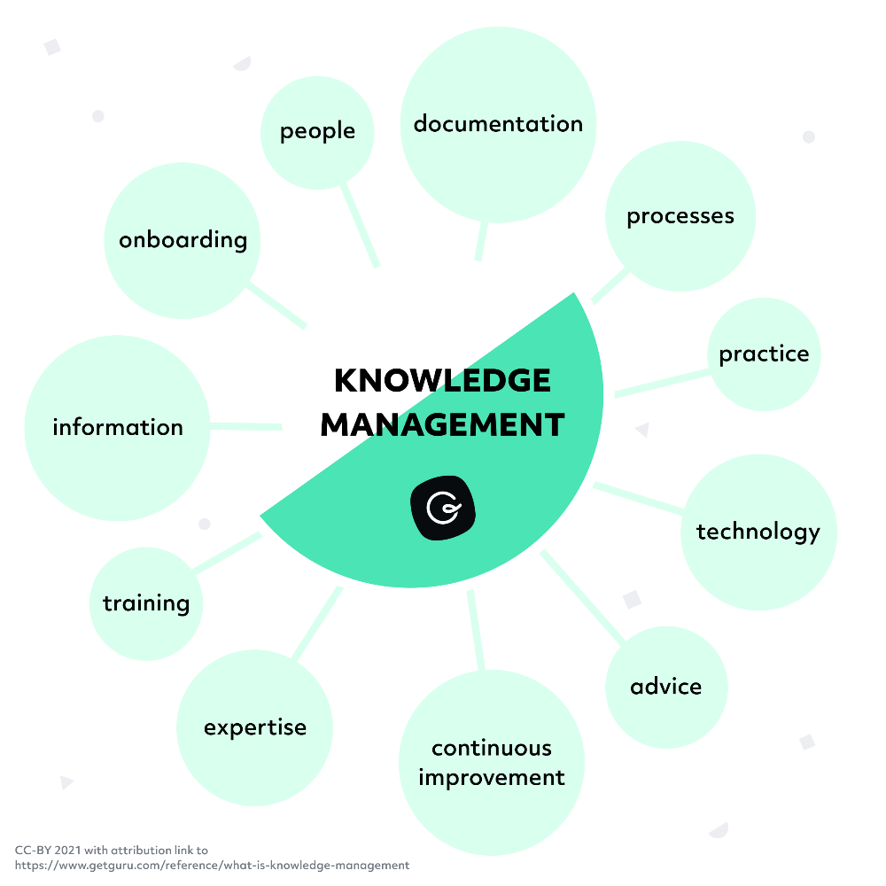
What kind of information is captured in knowledge management?

Slide 10
Why knowledge management fails
Holding onto knowledge. Some employees may want to hoard knowledge to maintain a particular position or level of importance within a company, while others may just not have time, interest, or a place to share it.
In all of these cases, information doesn't get documented, which means it can't be widely disseminated.

Slide 11
Searching is time-consuming. When companies lack a single source of truth, information can be spread across too many different apps.
If an employee doesn't know where to look or has to look in too many places for an answer, they may simply stop looking, and start relying on colleagues to get them answers quickly.
Information is outdated. If knowledge management processes are primarily used for document storage instead of knowledge application, old information proliferates making looking for the right answer exceedingly difficult.
In this case, again, employees simply stop relying on the knowledge base.

Slide 12
Who owns knowledge management?
Who owns knowledge management depends on the structure and size of the company. In smaller companies, it may be the responsibility of everyone to maintain the knowledge base and encourage good usage, while large enterprises may decide to employ a dedicated knowledge manager.

Slide 13
Knowledge management tools
Document management systems
‍These systems act as centralized digital filing cabinets for company documents. They make retrieving documents easy, support regulatory compliance, and enhance workflow.
In addition, when a document management system is enhanced with passwords and backup procedures, document security is enhanced, but not thoroughly protected from outside access.
Many typical document management systems have functionality limitations so custom upgrades can increase costs. This type of system does not automatically capture data or analyze it.

Slide 14
Content management systems
‍Content management systems are similar to document management systems, but store audio, video, and other media types in addition to documents.
Databases
‍A database is a computer application that allows people to capture, store, analyze, and interact with data. Databases are indexed in order to make information more accessible.
Data stored in databases can be very secure because the system prohibits manipulation.
However, they can be volatile and are often costly to design and set up. They also require a high level of skill to use and maintain.

Slide 15
Data warehouses
‍These enterprise-wide systems pull data from different parts of your organization and can be highly effective for reporting and analysis.
They store current, as well as historic data and transform data into meaningful information. However, data warehouses are typically high-maintenance systems that require complex integration in order to provide a unified view of the data.
Intranets
‍These private computer networks built on searchable platforms can provide an easily accessible resource for information that enhances collaboration and social networking within your enterprise.
But intranets do have some risks, including easy access by unauthorized personnel. In addition, they are costly and time-consuming to maintain.

Slide 16
Knowledge management strategies that drive productivity
Make it easy to share knowledge
Create a culture in which employees share knowledge freely with each other, instead of hoarding it.
This is done by implementing knowledge management tools that allow knowledge to be easily found and accessed.
Create repeatable processes
Don’t make employees re-invent the wheel every time they have important knowledge to share. Relying on templates and other easy-to-share and edit documents makes sharing knowledge even more effective and simple.

Slide 17
Incentivize knowledge creation
Reward those who contribute the most knowledge. Implementing knowledge management tools that make it easy for contributors to gain recognition can help encourage more people to contribute knowledge.
Encourage high usage
Asking questions is fine, but if employees are only interrupting colleagues to get answers instead of checking the knowledge base, start creating gentle reminders to check the KB before asking.
This not only saves them time, but it increases overall efficiency.

Slide 18
Knowledge management use cases
Employee onboarding
New employees need a lot of information very quickly to become effective members of the organization.
A knowledge management system can provide instant answers, ensuring everyone is on the same page from day one, limiting frustration and reducing training time.
Internal communications and updates
Good knowledge management can enhance collaboration by reducing chat noise. By using KM to create a dedicated place to ask and answer questions and provide updates, you're freeing up everyone's time to be more efficient.

Slide 19
Streamlined customer service
Since one of the main customer service metrics is ticket completion time, making sure reps have access to the information they need exactly when and where they need it makes good knowledge management a must.
Stop putting customers on hold or leaving tickets open for days (or weeks) while reps track down the person with the right answer by having that person provide it for everyone, once.
Product enablement
Keeping everyone up to date on the latest and greatest changes and updates to your product requires a streamlined solution accessible to everyone. Your knowledge management system should be available company-wide to ensure everyone knows what's available and when.

Slide 20
What is e-Governance?
Electronic governance or e-governance is adopted by countries across the world. In a fast-growing and demanding economy like India, e-governance has become essential.
The rapid growth of digitalisation has led to many governments across the globe to introduce and incorporate technology into governmental processes.
Electronic governance or e-governance can be defined as the usage of Information and Communication Technology (ICT) by the government to provide and facilitate government services, exchange of information, communication transactions and integration of various standalone systems and services.

Slide 21
In other words, it is the use of technology to perform government activities and achieve the objectives of governance.
Through e-governance, government services are made available to citizens and businesses in a convenient, efficient and transparent manner.
Examples of e-governance include Digital India initiative, National Portal of India, Prime Minister of India portal, Aadhaar, filing and payment of taxes online, digital land management systems, Common Entrance Test etc.

Slide 22
Types of interactions in e-Governance
Government to Government (G2G)
Information is exchanged within the government i.e., either, between the central government, state government and local governments or between different branches of the same government.
Government to Citizen (G2C)
The citizens have a platform through which they can interact with the government and get access to the variety of public services offered by the Government.

Slide 23
Government to Businesses (G2B)
The businesses are able to interact with the government seamlessly with respect to the services of the government offered to businesses
Government to Employees (G2E)
The interaction between the government and its employees occurs in an efficient and speedy manner.

Slide 24
Objectives of e-Governance
To support and simplify governance for government, citizens, and businesses.
To make government administration more transparent and accountable while addressing the society’s needs and expectations through efficient public services and effective interaction between the people, businesses, and government.
To reduce corruption in the government.
To ensure speedy administration of services and information.
To reduce difficulties for business, provide immediate information and enable digital communication by e-business.

Slide 25
Problems with e-Governance
Lack of computer literacy: India is still a developing country and a vast majority of the citizens lack computer literacy which hinders the effectiveness of e-governance.
Lack of accessibility to the internet or even computers in some parts of the country is a disadvantage to e-governance.
e-Governance results in a loss of human interaction. As the system becomes more mechanised, lesser interaction takes place among people.
It gives rise to the risk of personal data theft and leakage.
e-Governance leads to a lax administration. The service provider can easily provide excuses for not providing the service on technical grounds such as “server is down” or “internet is not working”, etc.

Slide 26
e-Governance in the Indian context
e-Governance in India is a recently developed concept. The launch of National Satellite-Based Computer Network (NICENET) in 1987 and subsequent launch of the District Information System of the National Informatics Centre (DISNIC) programme to computerise all district offices in the country for which free hardware and software was offered to the State Governments provided the requisite impetus for e-governance.
e-Governance thereafter developed with the growth of technology. Today, there are a large number of e-Governance initiatives, both at the Union and State levels. In 2006, the National e-Governance Plan (NeGP) was formulated by the Department of Electronics and Information Technology and Department of Administrative Reforms and Public Grievances that aims at making all government services accessible to the common man, ensure efficiency, transparency and reliability of such services at affordable costs to realise the basic needs of the common man.

Slide 27
The NeGP has enabled many e-governance initiatives like:
Digital India was launched in 2015 to empower the country digitally. Its main components are:
Developing a secure and stable digital infrastructure
Delivering government services digitally
Achieving universal digital literacy
Aadhaar is a unique identification number issued by UIDAI that serves as proof of identity and address on the basis of biometric data. It is being used to provide many benefits to the members of the society. One can e-sign documents using Aadhar.
myGov.in is a national citizen engagement platform where people can share ideas and be involved with matters of policy and governance.

Slide 28
UMANG is a Unified Mobile Application which provides access to central and state government services including Aadhar, Digital Locker, PAN, Employee Provident Fund services, etc.
Digital Locker helps citizens digitally store important documents like mark sheets, PAN, Aadhar, and degree certificates. This reduces the need for physical documents and facilitates easy sharing of documents.
PayGov facilitates online payments to all public and private banks.
Mobile Seva aims at providing government services through mobile phones and tablets. The m-App store has over 200 live applications which can be used to access various government services.
Computerisation of Land Records ensures that landowners get digital and updated copies of documents relating to their property.

Slide 29
State level e-governance initiatives include:
E-Seva (Andhra Pradesh) facilitates payment of utility bills, issuance of certificates, licenses and permits.
Khajane Project (Karnataka) digitalized the treasury system of the state.
FRIENDS (Kerala) is a single-window facility to pay taxes and other financial dues to the State government.
Lokvani Project (Uttar Pradesh) is a single-window solution relating to the handling of grievances, land record maintenance and providing a mixture of essential services.

Slide 30
Digital India programme
Minister Narendra Modi launched the much ambitious 'Digital India' programme on Wednesday,
July 1, at the Indira Gandhi Indoor Stadium in the national capital. Top industrialists like RIL
Chairman and Managing Director Mukesh Ambani, Tata Group chairman Cyrus Mistry, Wipro
Chairman Azim Premji and many others, were among the business honchos who shared their
ideas of taking digital revolution to the masses.

Slide 31
What is Digital India?
With the launch of Digital India programme, the government is taking a big step forward to transform the country into a digitally empowered knowledge economy. Includes various schemes worth over Rs 1 lakh crore like Digital Locker, e-eduction, e-health, e-sign and national scholarship portal.
BharatNet in 11 states and Next Generation Network (NGN), are also a part of Digital India campaign.
The programme includes projects that aim to ensure that government services are available to citizens electronically and people get benefit of the latest information and communication technology.
The Ministry of Communications and IT is the nodal agency to implement the programme.

Slide 32
Apps for Digital India
Digital India Portal
MyGov Mobile App
Swachh Bharat Mission App
Aadhaar Mobile

Slide 33
Vision Of Digital India
Digital Infrastructure as a Utility to Every Citizen
Governance & Services on Demand
Digital Empowerment of Citizens
Pillars Of Digital India
Broadband Highways
Universal Access to Phones
Public Internet Access Programme
e-Governance - Reforming government through Technology
e-Kranti - Electronic delivery of services
Information for All
Electronics Manufacturing - Target NET ZERO Imports
IT for Jobs
Early Harvest Programmes

Slide 34
Impact of Digital India by 2019
Broadband in 2.5 lakh villages, universal phone connectivity
Net Zero Imports by 2020
400,000 Public Internet Access Points
Wi-fi in 2.5 lakh schools, all universities; Public wi-fi hotspots for citizens
Digital Inclusion: 1.7 Cr trained for IT, Telecom and Electronics Jobs
Job creation: Direct 1.7 Cr. and Indirect at least 8.5 Cr.
e-Governance & eServices: Across government
India to be leader in IT use in services - health, education, banking
Digitally empowered citizens - public cloud, internet access

Slide 35
THANK YOU

